Slide 1

MINI PROJECT
(2020-21)
E-Commerce Shopping Website
MID-TERM REPORT
Institute of Engineering & Technology
Submitted by-
Shiv pratap singh bhadouria
(181500664)
Mohit Agarwal
(181500388)
Ayush Kumar
( 181500174)
Ayush Gupta
( 181500173)
Supervised By: -
Mr. Anand Prakash Gupta
Technical Trainer
Department of Computer Engineering & Applications

Slide 2
Contents
1. Introduction -------------------------------------------------------------------------------- | 3
3. Objectives ----------------------------------------------------------------------------------- | 8
4. Implementation Details------------------------------------------------------------------- | 11
6. Some Screenshots--------------------------------------------------------------------------- | 12
7. References----------------------------------------------------------------------------------- | 13

Slide 3
Abstract
Electronic Commerce is process of doing business through computer networks. A person sitting on his chair in front of a computer can access all the facilities of the Internet to buy or sell the products.
Unlike traditional commerce that is carried out physically with effort of a person to go & get products, ecommerce has made it easier for human to reduce physical work and to save time. E-Commerce which was started in early 1990’s has taken a great leap in the world of computers, but the fact that has hindered the growth of e-commerce is security. Security is the challenge facing e-commerce today & there is still a lot of advancement made in the field of security.
The main advantage of e-commerce over traditional commerce is the user can browse online shops, compare prices and order merchandise sitting at home on their PC.
For increasing the use of e-commerce in developing countries the B2B e-commerce is implemented for improving access to global markets for firms in developing countries. For a developing country advancement in the field of e-commerce is essential. The research strategy shows the importance of the e-commerce in developing countries for business applications.
Introduction
1.1 Definition of E-commerce
Electronic commerce or ecommerce is a term for any type of business, or commercial transaction, that involves the transfer of information across the Internet. It covers a range of different types of businesses, from consumer based retail sites, through auction or music sites, to business exchanges trading goods and services between corporations. It is currently one of the most important aspects of the Internet to emerge.
.

Slide 4
1.2 Working of E-COMMERCE
The consumer moves through the internet to the merchant's web site. From there, he decides that he wants to purchase something, so he is moved to the online transaction server, where all of the information he gives is encrypted. Once he has placed his order, the information moves through a private gateway to a Processing Network, where the issuing and acquiring banks complete or deny the transaction. This generally takes place in no more than 5-7seconds..
There are many different payment systems available to accommodate the varied processing needs of merchants, from those who have a few orders a day to those who process thousands of transactions daily.With the addition of Secure Layer Technology,E-C0mmerce is also a very safe way to complete transactions
Present Challenges Facing E-Commerce
Speaking of obstacles, there are a lot of them that need to be uprooted before e-commerce can compete with traditional commerce. The biggest obstacle in the course of advancement of e-commerce is that the consumer's senses are limited to seeing and hearing the product. The second largest problem that e-commerce has been facing over the past few years is that of security. Traditional buyers and sellers are still paranoid about conducting business online. According to Hal Loevy, vice president of Global Marketing and Partnerships for SGSonSITE, "Despite all the noise about e-commerce, which is significant, companies still have to keep their old business practices: Can I trust who I am buying from? Who am I doing business with? What is their trading history? Am I obeying the law? Will I receive the goods as specified on screen and who do I approach if I have a problem?". According to emarketer.com, "70% of US consumers are concerned about online security; this discourages consumers from using credit cards to shop online (PaymentOne)". Also according to e-marketer.com, in December 2001, 91% of websites collected personal information and in April-May 2001, 68% of US Internet users were concerned that transactions may not be secure and other companies and individuals might gain access to their personal information.

Slide 5
1.3 Some recent technological breakthroughs
Finally, in order to make the online shopping experience even more better, there are a lot of new technologies like Verifi, DigiScent's iSmell and TouchSense that have emerged over the last couple of years. Even though iSmell and TouchSense are very new technologies and they haven't been adopted by the majority of internet shoppers yet, they promise a consumer-friendly future. Verifi is one technology that has been widely adopted today, and for good reason. According to a recent BizRate study, over 50% of online shoppers stated that they would not make further purchases from a Web merchant that delivered an item in a colour that wasn't what they expected. This is the problem that Imation have designed their Verifi system to solve. Here's how it works. When a shopper visits a Verifi-enabled Web site for the first time they are invited to take a Web based survey that establishes how their monitor, computer, operating system and browser handle color. This information in then stored as a cookie in the shopper's browser. Then, when they view a product image, the Verifi system reads the information in the cookie and combines this with the profile of the scanner (or digital camera etc.) that the merchant used to produce the image to generate a color-accurate image in the shopper's browser.
The reality of E-Commerce with developing countries
The report is about the potential offered by internet based business-to-business (B2B) e-commerce for improving access to global markets for firms in developing countries .It addresses three questions:
v Is B2B e-commerce opening new and cheaper access to global markets for developing country producer firms or, conversely, is it strengthening existing buyer-producer relationship and existing power relations?
Are developing country producers being marginalized by the spread of B2B e-commerce trading relationships that depend on sophisticated information and communication technologies (ICT’s) and on efficient logistics systems, electronic payment systems and new certification procedures?
v How can governments or technical assistance agencies help producers in developing countries to participate in B2B e-commerce developments on an equitable basis?
The question have been answered on how internet-based electronic marketplaces were actually working in 2001-2002 and how firms in developing countries were using internet applications to support and enhance their business support. This study does not examine any aspects of B2B e-commerce.

Slide 6
1.4) B2B e-commerce expectations and assumptions
The idea that B2B e-commerce would radically transform the way firms to do business can be summed up in four propositions about how this form of e-commerce is expected to work. These are taken from the publications of just two UN organizations concerned with trade and development, UNCTAD and ITC. However, the broadly reflect the general state of the expectations for B2B e-commerce in 2000 and 2001.
Proposition 1: e-commerce works through ‘many-to-many’ e-marketplaces
B2B e-commerce marketplaces are on-line spaces were many buyers and sellers can come together in one trading community and obtain sufficient information to make decisions aboutwhether to buy or sell. UNCTAD’s 2001 E-Commerce and Development Report suggested that ‘many-to-many’ e-marketplaces would become the dominant component of e-commerce activity and argued that.“E-markets involve a large number of buyers and sellers that engage in many-to-many transactions and relationships. They create a trading community in buyers’ orders are matched with sellers offers’ and the trading partners benefit from other forms of collaboration”
Proposition 2: B2B e-commerce offers greater returns to firms in developing countries thanother trading channels.
B2B e-commerce offers two important advantages for developing country firms.
First, e-commerce related transaction costs are less sensitive to distance than traditional marketing channels, so access to global markets is made easier.
Second, by simplifying and making market channels more efficient, B2B e-commerce enable developing country firms to retain a large share of the final consumer price of products. The process is not necessarily one of disintermediation, but rather one of more efficient, internet –based intermediation.

Slide 7
Hardware Requirements
Memory [4GB RAM (or higher)]
Intel core i3 64-bit Processor (or higher)
1.5 Software requirements
Sublime Text
Atom

Slide 8
Objective
Ecommerce business drives profitable growth with reduction is cost-to-customer, developing customer-reach, and providing a unique customer experience. It has become more than essential for B2B as well as other businesses to make the right use of ecommerce. Now, ecommerce is evolving or better say evolved into digital commerce that implies to the entire business journey from buying to delivery with an online experience. Below are the few objectives of ecommerce:
1. Reduce management costs
Businesses aim at reducing the costs incurred for the betterment of their revenue. Automating the ecommerce business can help in reducing the management cost significantly. Moreover, the right use of digital marketing can help in reducing the cost spent on driving customers to such an extent that businesses can bring customers for free of cost.
2. Developing business relations
With ecommerce as the primary use, business development can be easily achieved. The direct communication between a company and the customer, the business relationship can be boosted. Eventually, the ecommerce market shall be expanded.
3. Providing a unique customer experience
Uncountable ecommerce businesses are functioning out there in the market. When a customer searches for a certain product (for instance, shampoo), they will probably click on the first three links that are shown on the Google Search Engine Results Page. All the rest links are either avoided, never seen, or are visited by a few. This itself shows the competition in the ecommerce market. One of the best ways to stand out from the crowd is by providing a unique customer experience. This includes giving a personalized experience to each customer or visitor of your online store, website, or mobile app. Some other pointers to consider are round the clock customer service, immediate responses to the queries rose, engaging with the customers, and so on.
4. Increasing the number of loyal customers
Customers are the core of all business strategies. Therefore, ensuring the great customer experience is of prime importance for the growth of the business. You need to meet your customers where they spend their time. More than 60% of consumers look for purchasing goods and services online. If you meet your customers where they are already active, the chances of them, interacting with your business increases two folds. You can increase the number of loyal customers by giving the best experience to your already existing customers as well as bring in newer customers.
5.

Slide 9
5. Boosting the efficiency of services
With the continually evolving technology, you need to enhance the efficiency of your services. By choosing an online ecommerce platform to create an online store, you can efficiently reduce the cost of managing and selling online. You have various opportunities to boost the efficiency of your service that eventually enhances the revenue earned. By reducing the delivery time, you can witness happy customers getting back to your business two times faster. Another way is to provide your customers with automated services such as status update, invoice creating, chat support, etc. When you update your efficiency of delivering products or services to your customers, you are creating a strong online presence that helps you sell more.
6. Developing relevant target
Developing relevant traffic for an ecommerce business is a common objective. Whether an ecommerce website or an online store, building traffic is one of the most important objectives. However, you should know that not all traffic is useful for your business. If you are successfully creating traffic for your ecommerce site or store, but most of the people in the traffic do not require the products or services you provide, the traffic is not causing any good to your business. For instance, your marketing strategies were attractive enough for teenagers; your business would not be receiving any boost in sales. Therefore, along with boosting your traffic, you need to analyze your traffic. Here comes the need for collecting customer data. Collecting customer data include demographics such as age, location, and gender, customer interests, browsing history, browser history, and so on. By saving these data, you can aim in targeting the relevant market.
7. Making responsive ecommerce website
With the increasing use of smartphones for shopping online, it has become more than mandatory for ecommerce businesses to go mobile. Apart from creating a native mobile app, like the one offered from Builderfly, you need to create a responsive ecommerce website. It is one of the major objectives of all leading ecommerce businesses. By responsive, it means to create a website that can be viewed from any devices of varying screen size, equally. Studies say that Google may next rank a website based on its mobile website. It means that any website that has a responsive design would be ranked on top of the website that does not have one. Making your ecommerce website responsive can help you optimize it. A mobile-friendly website earns more traffic than the rest.

Slide 10
8. Increasing sales
The objective of increasing sales will always remain continuous and constant for an ecommerce business. In order to thrive in the ecommerce industry, you need to boost your sales, constantly. All other objectives are zeroed down to make this objective happen. However, you also need to look into your past store analytics and figure out the marketing tactics that have worked well for you to increase sales. Although these objectives could help you in gaining sales, nothing can beat the tried and tested marketing tactics for your business. For instance, the products that are sold the most, ideally the best seller can be used for remarketing and grab more attention. Any marketing strategy you used earlier including the email targeting and traffic boosting tactics must be revisited and worked upon to increase sales. Based on the above-mentioned objectives and the marketing tactics that actually worked for you, you need to design your marketing plan. Only you can decide what is perfect for your business and what is not. Every business is unique, and so is yours!
Choosing the right ecommerce solutions is extremely important for business development. Consider investing your time and research in builderfly.com. It is a complete ecommerce solution that lets you take any offline business online, create a fully customizable online store, and create a personalized mobile app. The 14-day free trial lets a user explore the extensive features of Builderfly and once upgraded to a suitable plan, they can even connect an already existing domain name. To choose an online platform or to not, completely depends on your business requirements and company revenue. Your ecommerce store should not limit selling online due to lack of efficiency.

Slide 11
Implementation
Implementing an e-commerce shopping cart gives your business the ability to sell your products online day and night, reach new clients, target your ideal market, establish a strong brand, and build closer relationships with your customers by improving their purchasing experience.
Whether you’re setting up an online store for the first time or updating your current platform, platform implementation is one of the most complex aspects of launching an e-commerce site. Without the guidance of a consultant with years of e-commerce experience, programming expertise and deep knowledge, your efforts to set up an e-commerce solution can become plagued by cost overruns, programming errors, and delays resulting in poor sales performance and reduced profits.
Simplicity has over 20 years of e-commerce implementation experience. We have been helping businesses just like yours, big and small, build e-commerce platforms to get their businesses up and running on the web. Contact us today to see how we can get your business’ e-commerce store implemented and making money.
Advantages of eCommerce implementation:
Allows you to sell products 365 days a year, 24 hours a day.
Lowers your costs and raises your sales margins
Creates cost-saving efficiencies
Creates an automated cycle of repeat business
Connects you to new customers previously unavailable to you due to distance and operating hours
Collects customer data, demographics, and produces marketing leads
Gives your customers control over how and when they’d like to shop
E-Commerce Implementation gives you the tools to expand your client base and the control to run your business efficiently and cost effectively .

Slide 12
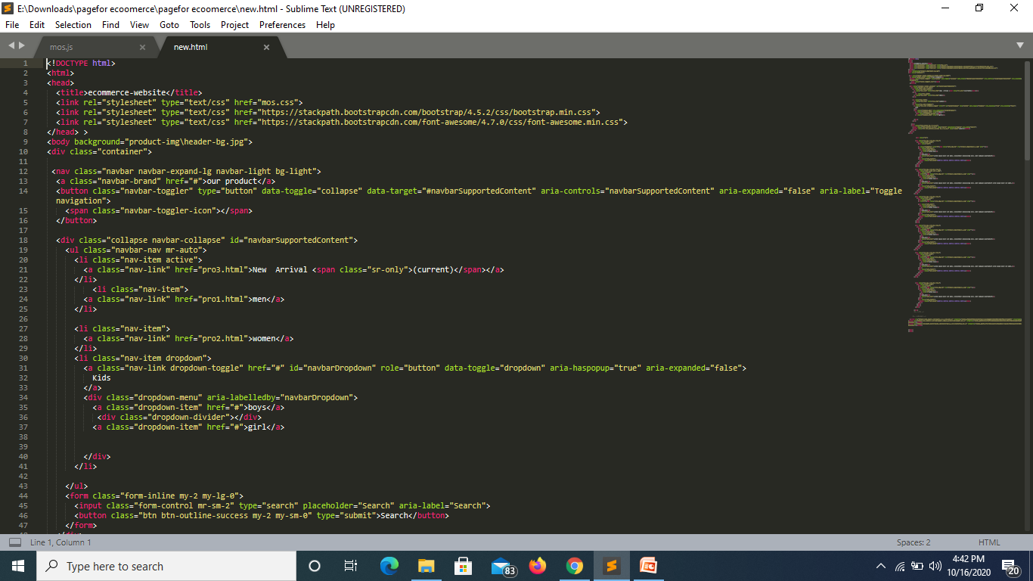
Implementation

Slide 13
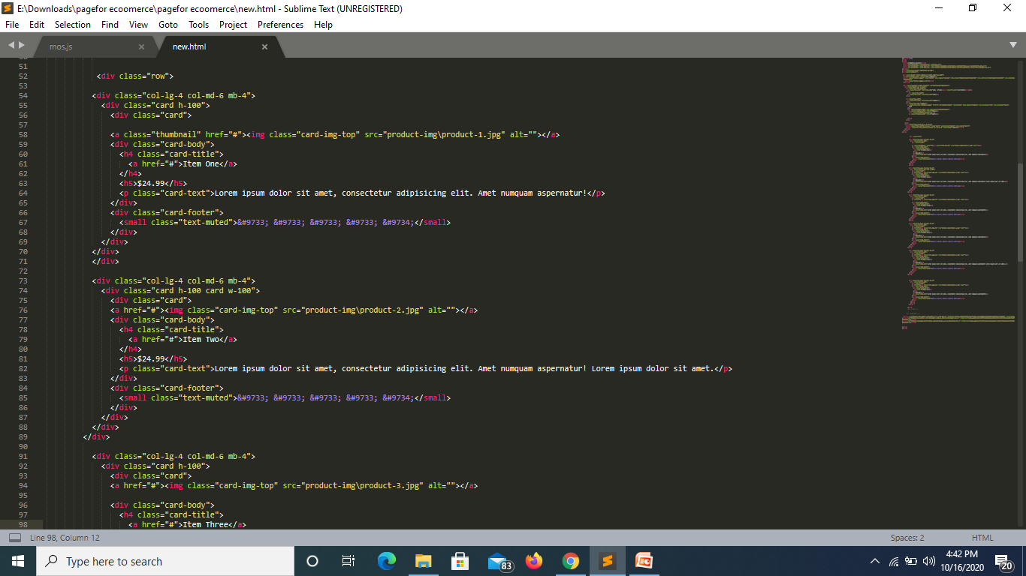
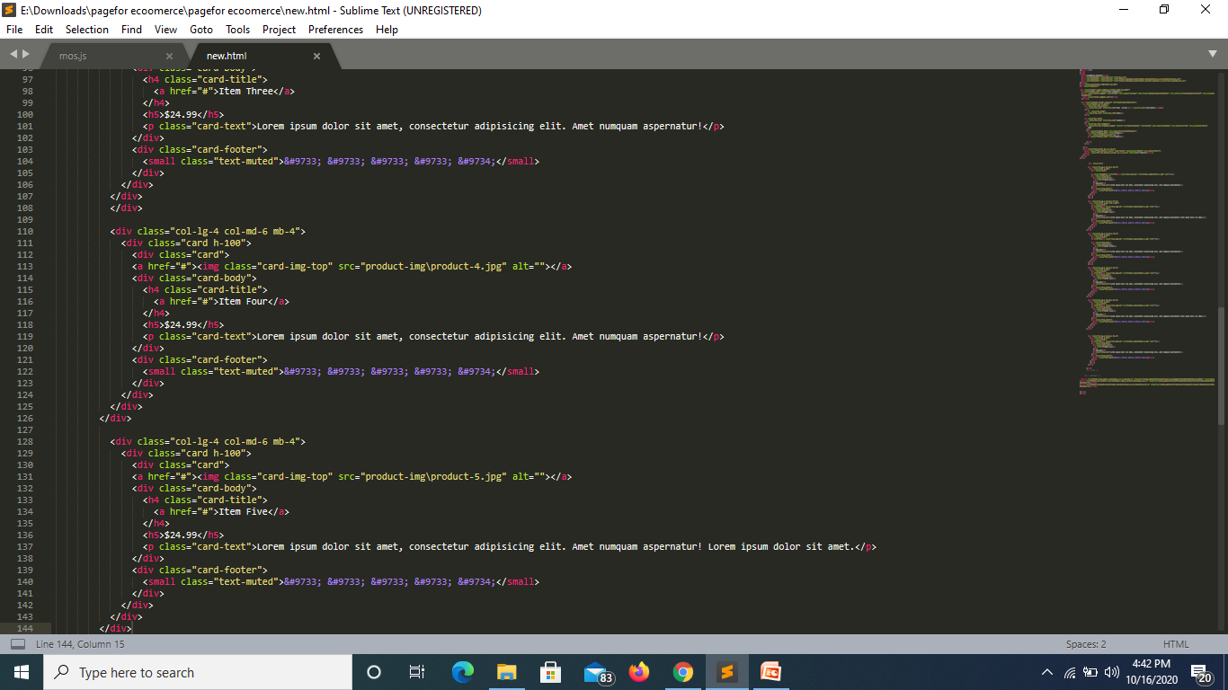

Slide 14
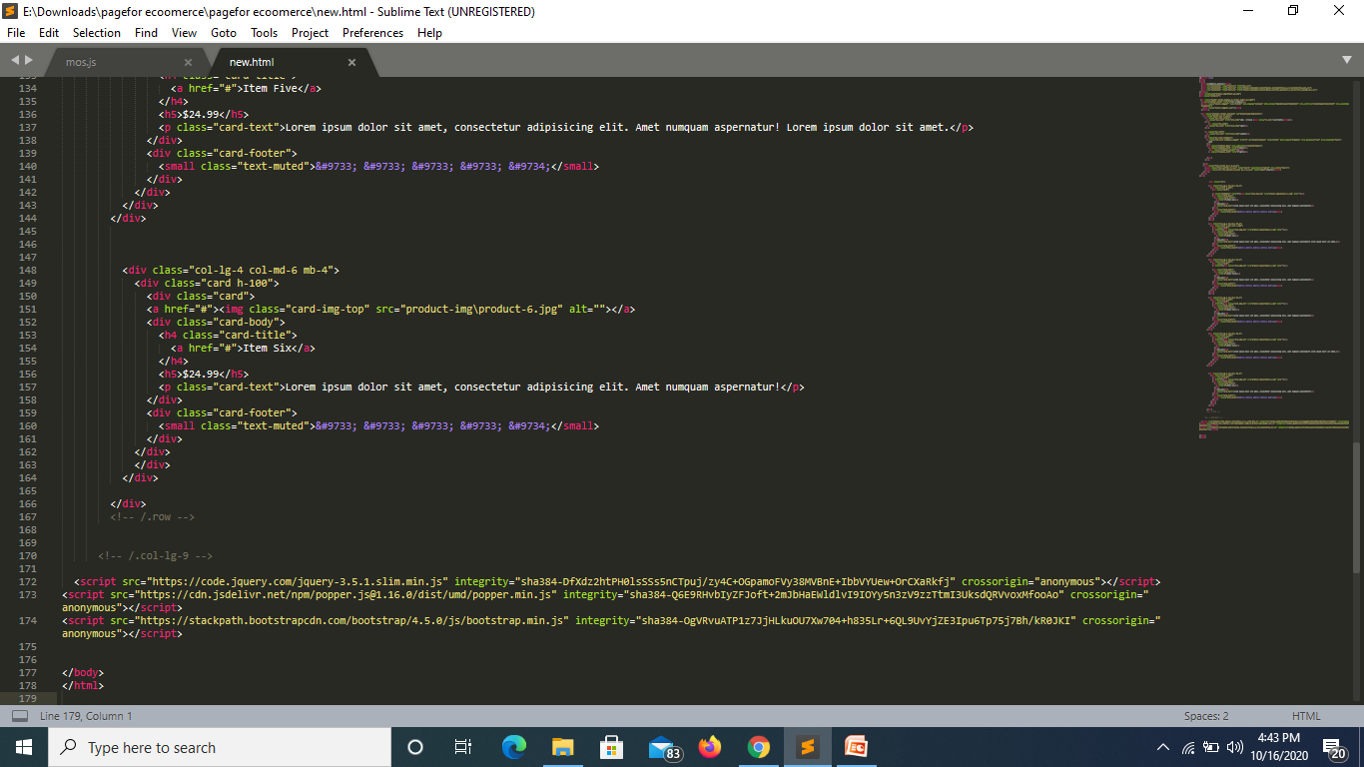
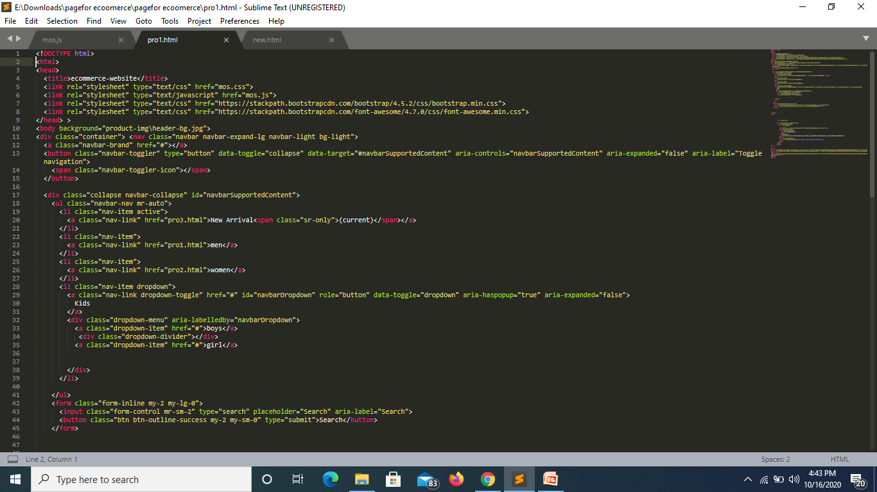
SCREENSHOTS

Slide 15

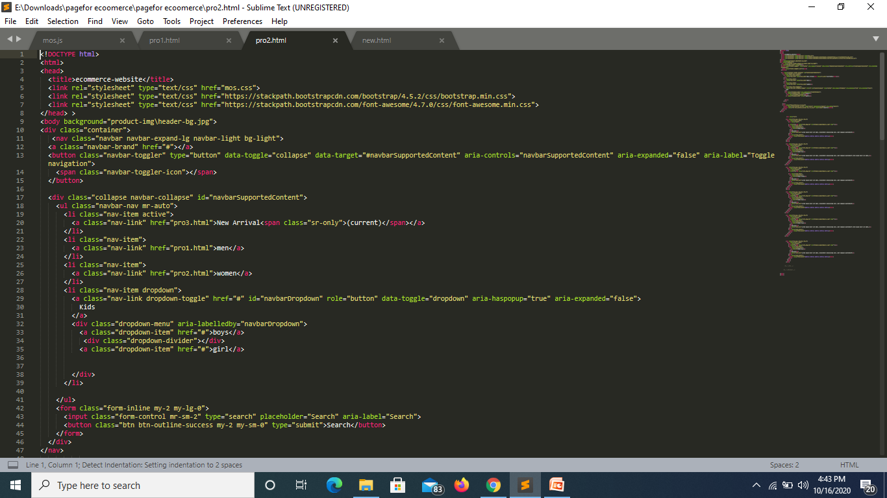

Slide 16
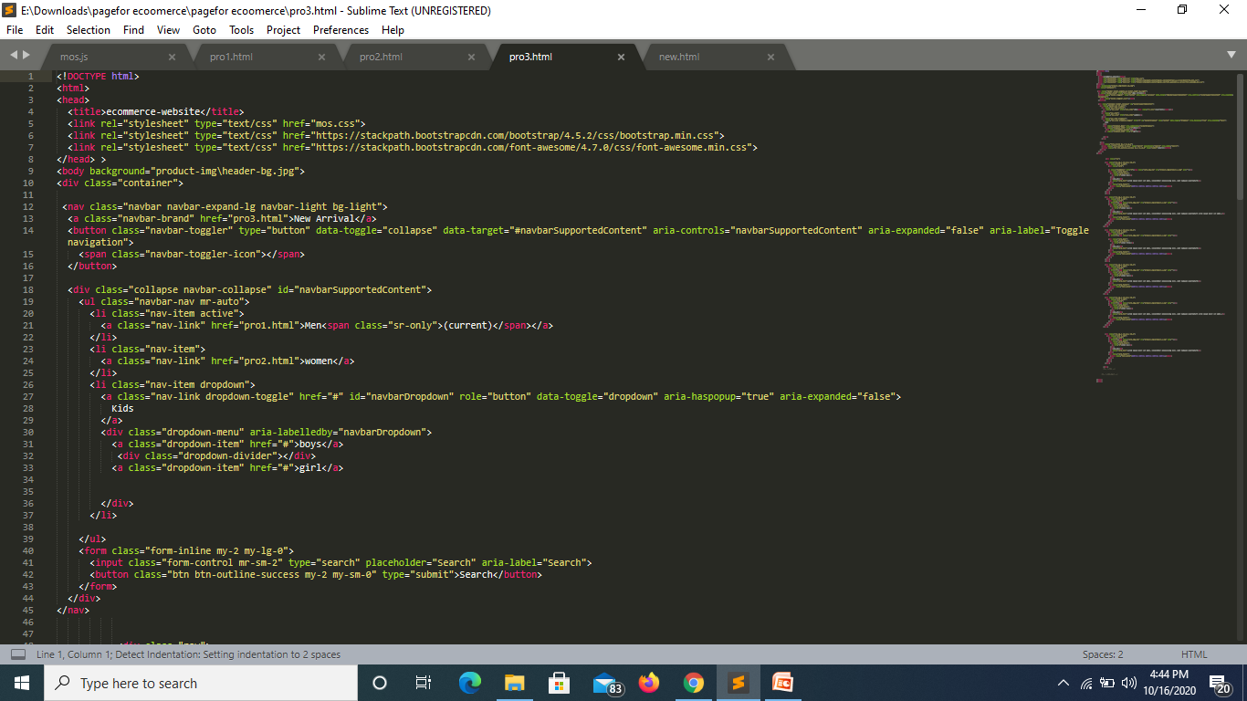
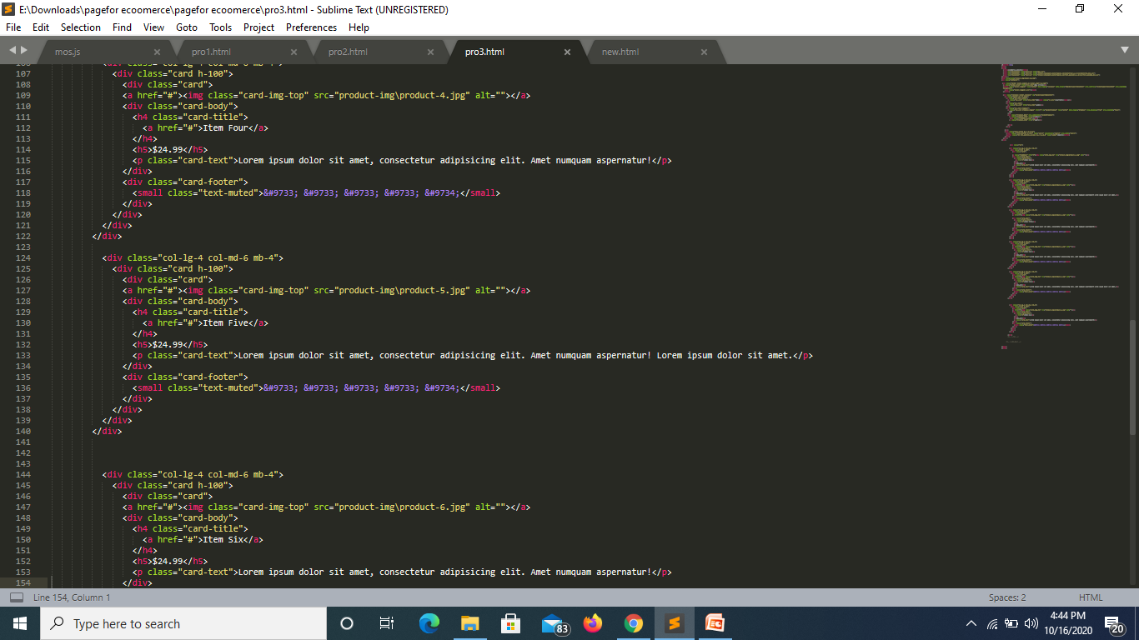

Slide 17
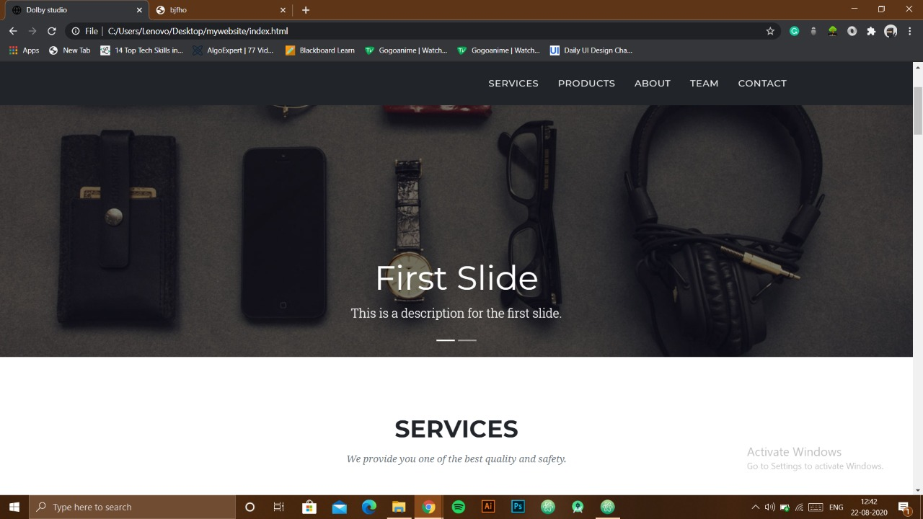
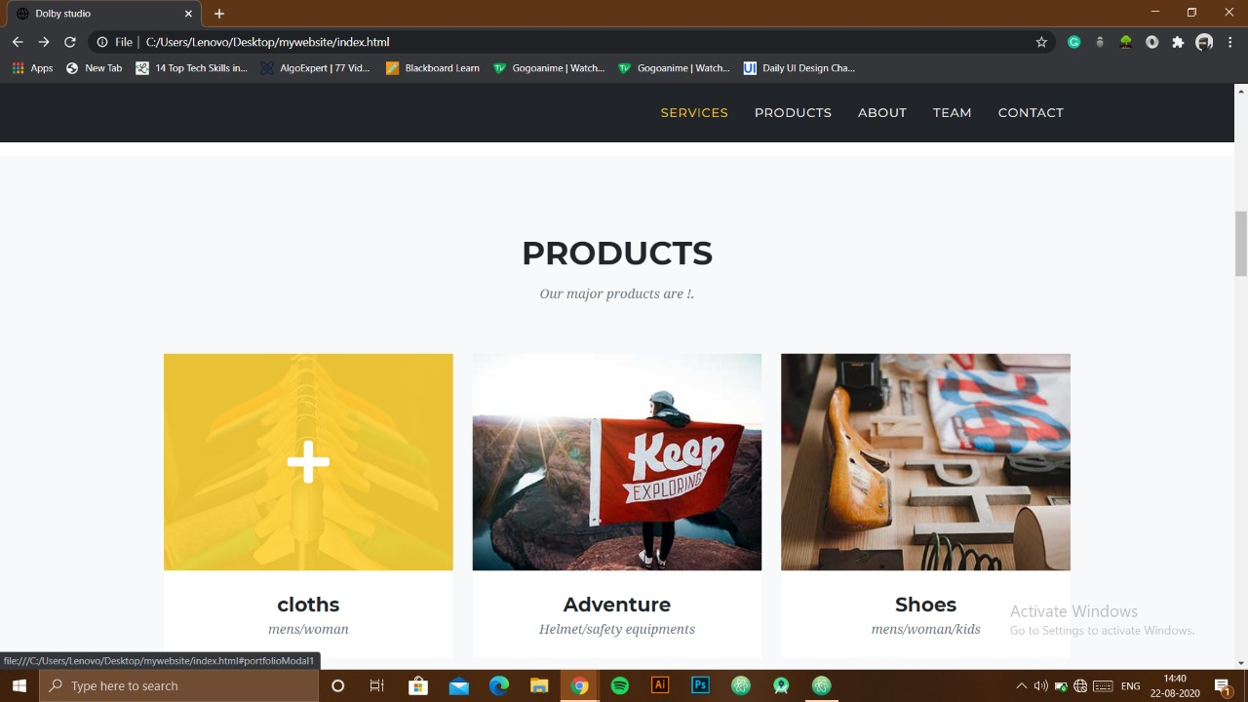

Slide 18

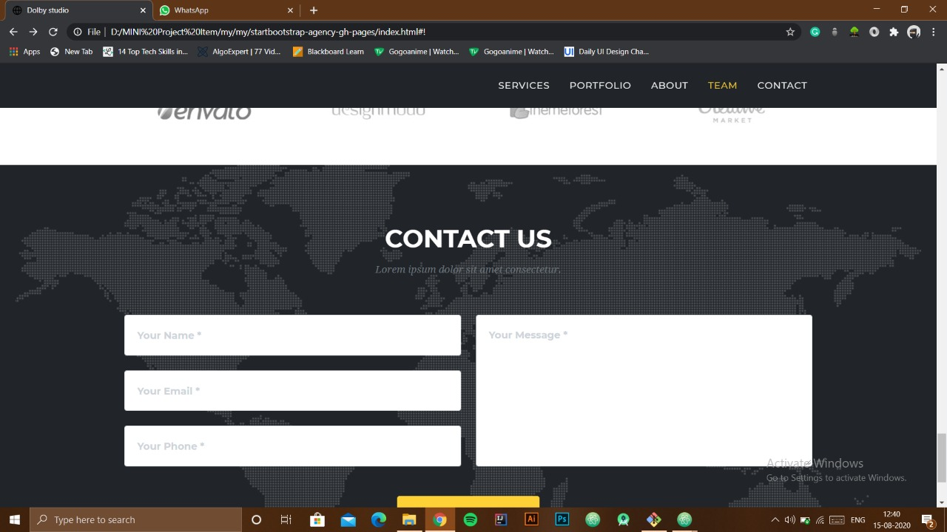

Slide 19
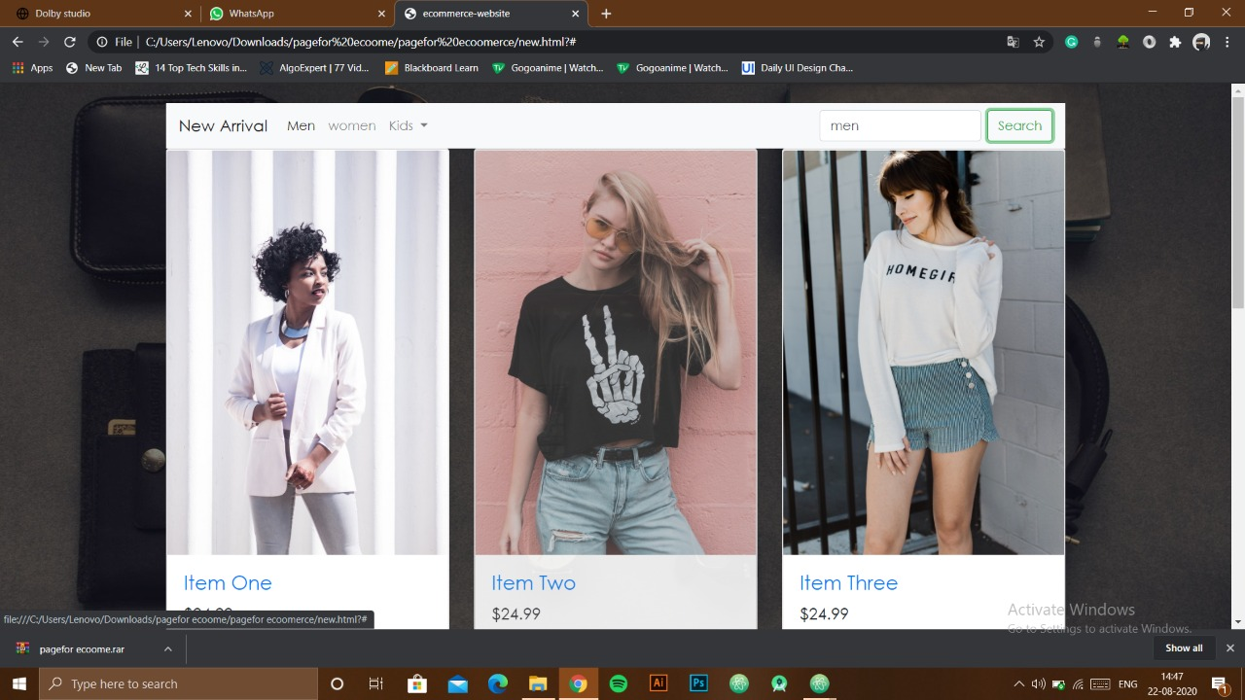
GITHUB: https://github.com/Shivbhadouria/Ecommerce-site-Mini-project.git

